Slide 1

Analysis and Visualization of U.S. Accident Data
Jack Cook, Amanda McCreary, Carrie McDowell, Nick Pierce

Slide 2
Motivation
We chose to analyze historical vehicle accident data to better understand when, where, and why accidents occur in the U.S.
We asked which states ranked highest in accidents. We then wanted to know when they occurred, (i.e. month, time, day, year).
We wondered if accidents increase with heat and humidity so we looked at that data next, and then what the weather was like at the time of accidents.
The data answered all of our questions and as a bonus other interesting facts were revealed as well.

Slide 3
Questions & Data
The data set was quite large so we broke it down into 4 CSV files.
For the first question, we used data from the location file. We retrieved the number of accidents from each state listed.
Next, we used the date_time file to answer the questions of month, time of day, day, and year accidents occurred. To do this, we first extracted the day(int), day(string), month and year from the time stamp. Next we used Python and Excel to bin and chart the results.

Slide 4
The Data
The data used in this project came from the Kaggle.com website.
Data Cleanup & Analysis
The original data set contained 2.25 million historical records and was too large to read into a jupyter notebook.
The first step was to decide what attributes to use in our analysis. Data that was not pertinent to our analysis was omitted from the original dataset.
Still too large, to read-in, we broke the data set up into four csv files. Once read-in, we concatenated the files for use in our analysis.

Slide 5
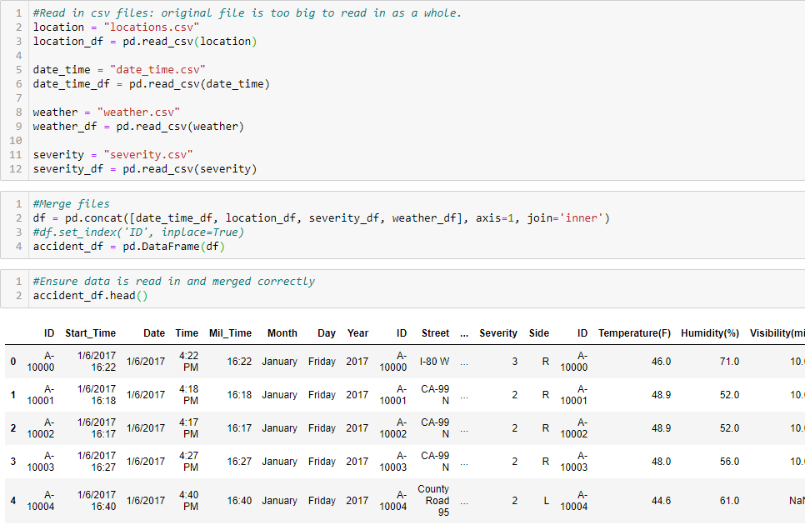
Concatenation

Slide 6
Fact Tidbits
In 2019, it was reported that there are more than 128 million households in the U.S.
It is projected that by 2020 there will be more than 230 million licensed drivers in the U.S.(Wagner, 2019)

Slide 7

A little Humor
(Vaughan, ND)

Slide 8
RStudio
We wrote code into RStudio to generate a data profiling report on the dataset.

Slide 9
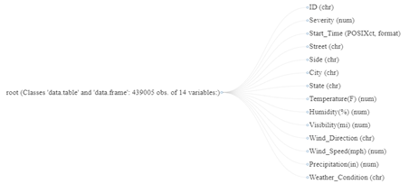
Data Profiling Report
Looking at the data types

Slide 10
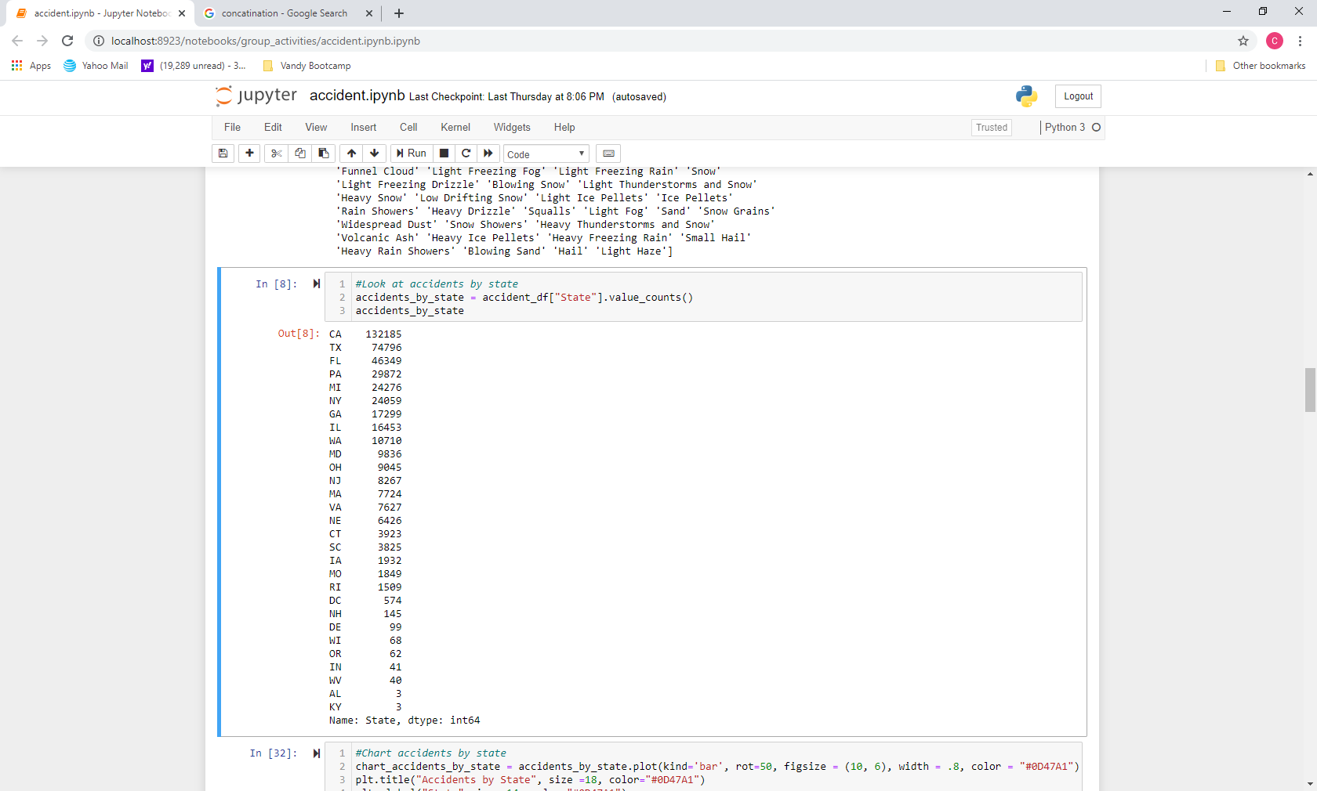
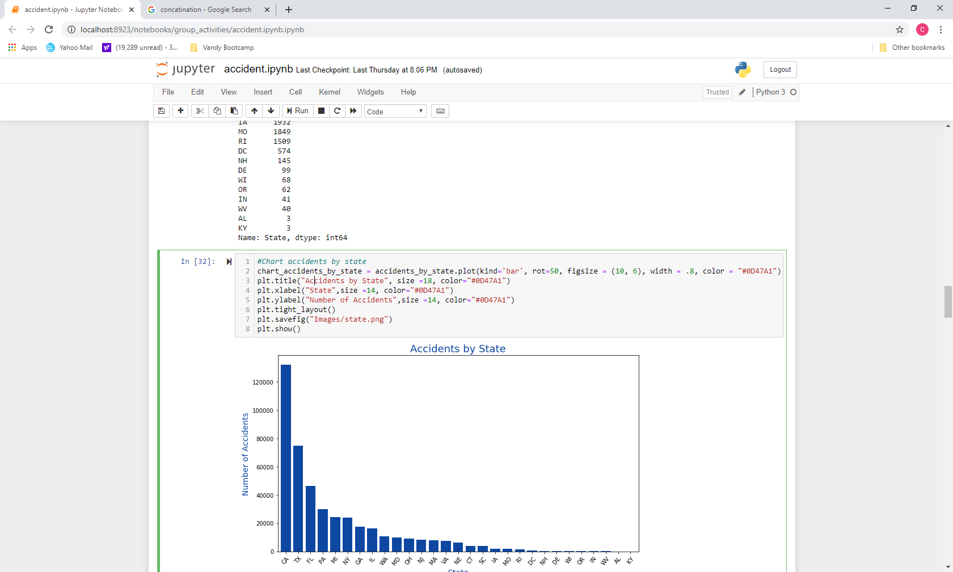
Python code used to retrieve state data and create a chart

Slide 11
Accidents by 30 States

Slide 12
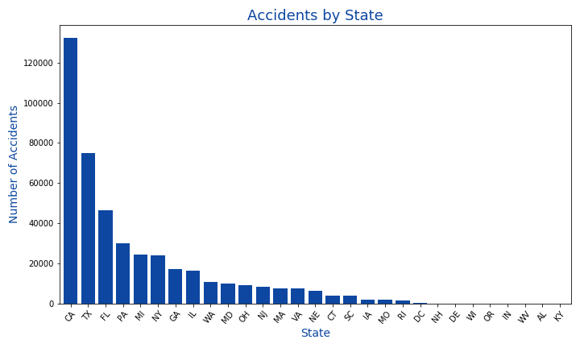
Accidents by 30 States

Slide 13
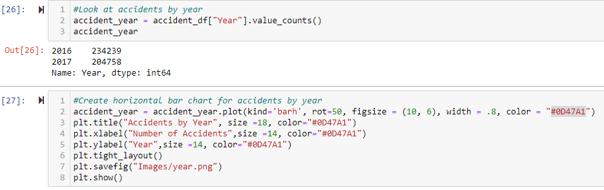
Python code used to retrieve accident-by year and create a chart

Slide 14
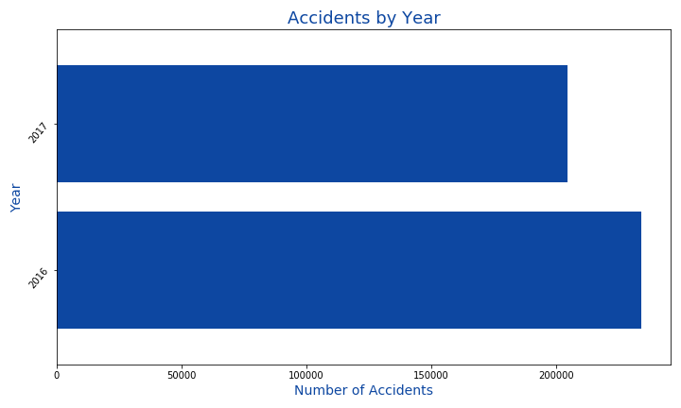
Accidents by Year

Slide 15
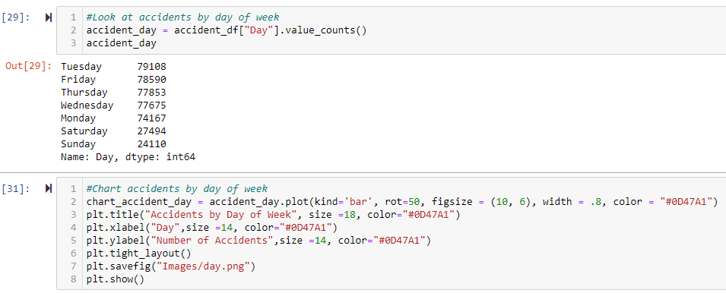
Python code used to retrieve accident-by-day and create a chart

Slide 16
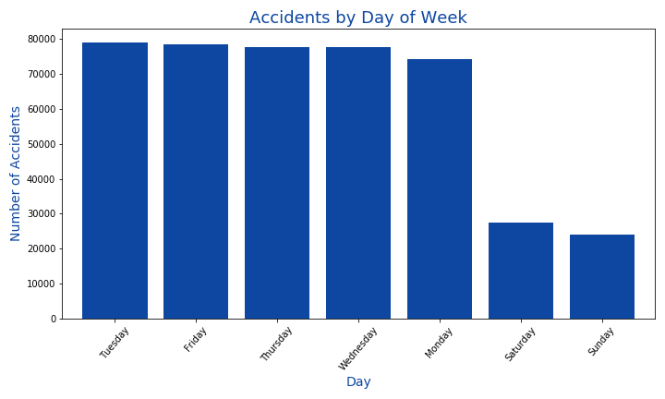
Accidents by Day

Slide 17
Python code used to retrieve accident-by-day and create a chart

Slide 18
Excel
We used Excel to bin accidents by month and, time, and then the temperature and humidity at time of accident.
We then used the plot function in excel to create the next four plots.

Slide 19
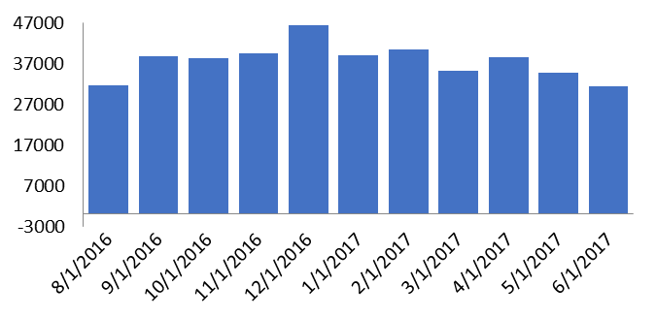
Accidents by Month

Slide 20
Temperature at Time of Accident
Bin | Frequency
-13 | 2
32 | 22962
50 | 68213
60 | 68855
70 | 101865
80 | 87293
90 | 65880
100 | 13344
110 | 683
124 | 27

Slide 21
Humidity at Time of Accident
Bin | Frequency
0 | 0
10 | 1260
20 | 7679
30 | 18333
40 | 32970
50 | 51199
60 | 62487
70 | 66017
80 | 63377
90 | 70993
100 | 54222

Slide 22
Time Of Accidents
Bin | Frequency
12:00 AM | 62
1:00 AM | 3701
2:00 AM | 2927
3:00 AM | 3260
4:00 AM | 2641
5:00 AM | 5506
6:00 AM | 8938
7:00 AM | 17461
8:00 AM | 30531
9:00 AM | 37317
10:00 AM | 31060
11:00 AM | 28282
12:00 PM | 28640
1:00 PM | 23059
2:00 PM | 20679
3:00 PM | 22751
4:00 PM | 21394
5:00 PM | 26098
6:00 PM | 29748
7:00 PM | 26087
8:00 PM | 21957
9:00 PM | 19832
10:00 PM | 13160
11:00 PM | 9728

Slide 23
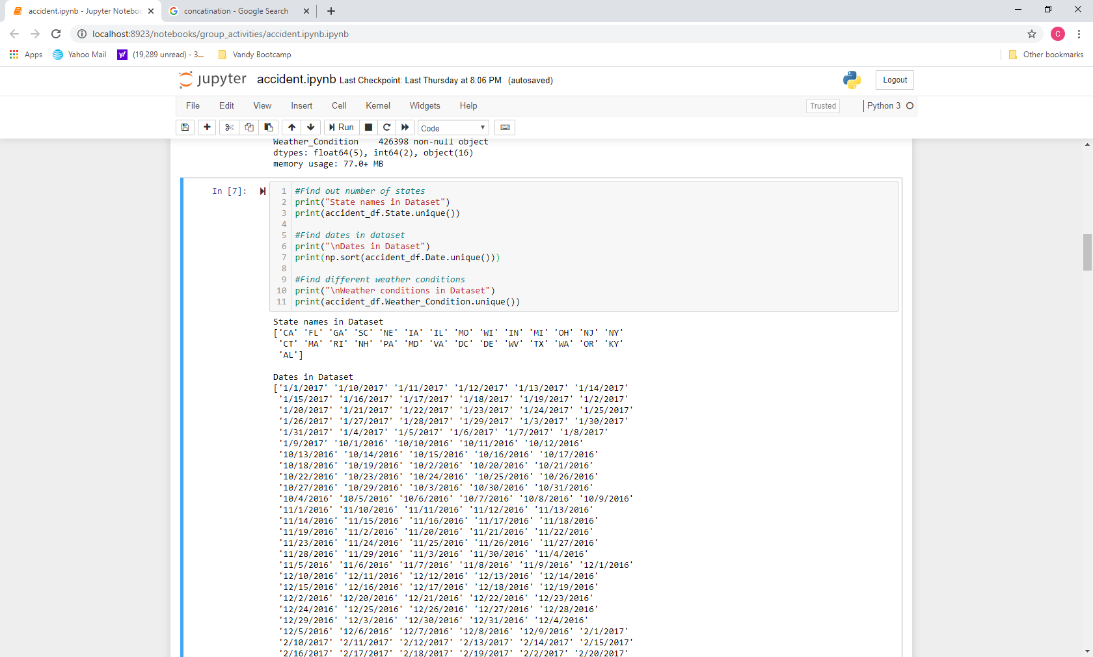
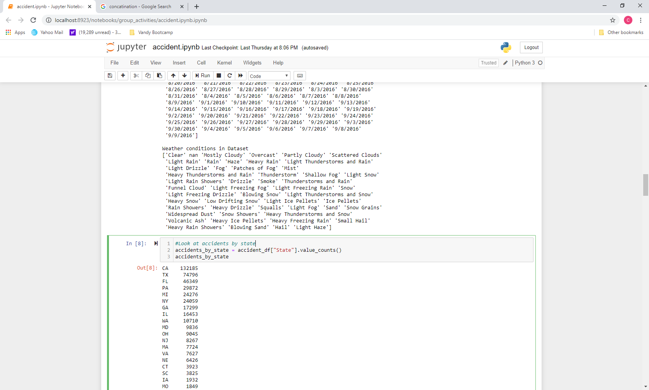
Weather Conditions
We broke out the weather conditions variable to view the many levels using Python.

Slide 24
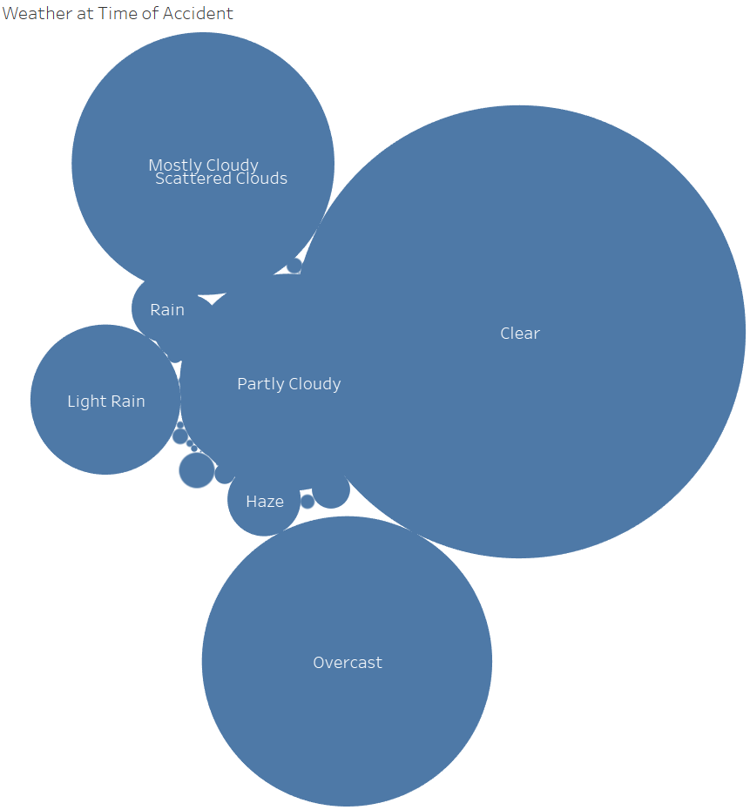
Tableau
This bubble chart was created using Tableau
As seen, most accidents occur when the weather condition is clear.
Here are the top ten data points:
Clear - 175,342
Overcast - 71,974
Mostly Cloudy - 39,536
Partly Cloudy - 40,311
Light Rain - 19,250
Haze - 4,587
Rain - 4,045
Light Snow - 3,845
Fog - 1,616
Heavy Rain - 1,245

Slide 25
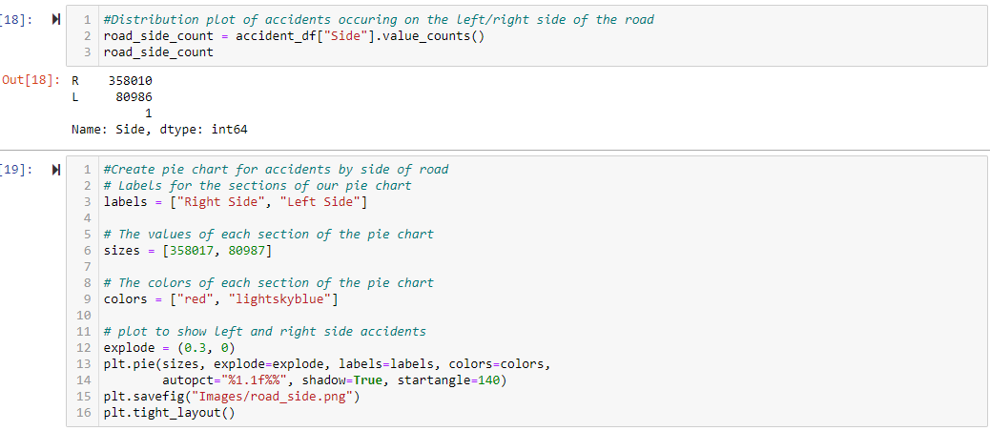
Distribution of Accidents L/R Side

Slide 26
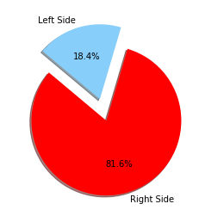
Number of Accidents Left/Right Side
Left Side
80,987
Right Side
358,005

Slide 27
Most Popular Street Name?
Can you guess the most popular street name accidents occurred on?

Slide 28
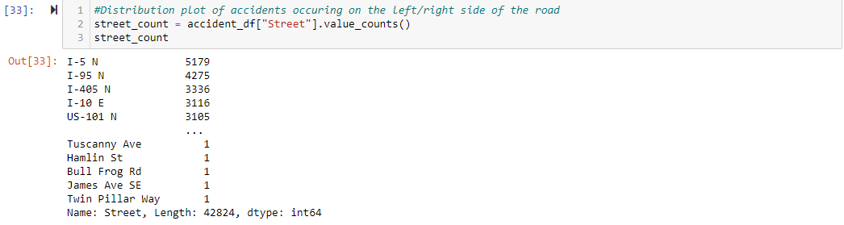
Most Popular Street
We were interested in street names , from the output above, we plotted the top six

Slide 29
Top 6 Most Popular Streets

Slide 30

(USEReady, 2016)

Slide 31
Thank You!

Slide 32
Post Mortem
Problems arose from the start. The data file was too large for Jupyter or GitHub. There were four years of data in the set.
Next we found that there was no full year of data and not all states were represented. In hindsight we should have chosen a different dataset but was too deep into it. We could not do anything about the states, we were able to extract a full year of data using the second half of 2016 and first half of 2017.
If we would have had more time, we may have found a dataset complete with all states and years. Also data such as age and sex of driver would be a good compliment.

Slide 33
References
Duffin, E. (2019, November 28). U.S.: Number of households 1960-2019. Retrieved December 28, 2019, from https://www.statista.com/statistics/183635/number-of-households-in-the-us/.
Moosavi, Sobhan, Mohammad Hossein Samavatian, Srinivasan Parthasarathy, and Rajiv Ramnath. “A Countrywide Traffic Accident Dataset.”, 2019.
Moosavi, Sobhan, Mohammad Hossein Samavatian, Srinivasan Parthasarathy, Radu Teodorescu, and Rajiv Ramnath. "Accident Risk Prediction based on Heterogeneous Sparse Data: New Dataset and Insights." In proceedings of the 27th ACM SIGSPATIAL International Conference on Advances in Geographic Information Systems, ACM, 2019.
USEReady. (2016, June 15). 10 Geeky Business Analyst Jokes. Retrieved December 22, 2019, from https://www.blog.useready.com/infobytes/business-analyst-jokes.
Vaughan, P. (n.d.). How to Make a Meme That Will Make People Cry (With Laughter). Retrieved December 22, 2019, from https://blog.hubspot.com/blog/tabid/6307/bid/33363/memejacking-the-complete-guide-to-creating-memes-for-marketing.aspx.
Wagner, I. (2019, February 14). Highway Statistics 2017 - Policy: Federal Highway Administration. Retrieved December 28, 2019, from https://www.fhwa.dot.gov/policyinformation/statistics/2017/.

